Slide 1
Priority
Queue

Slide 2
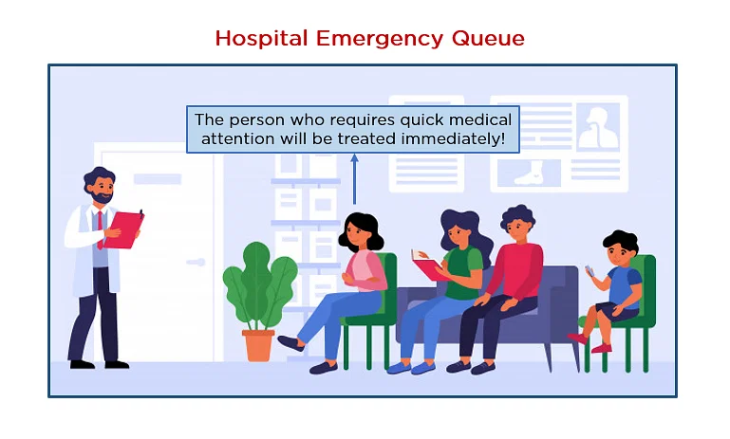
Priority Queue
A priority queue is a type of queue that arranges elements based on their priority values

Slide 3
Priority Queue
Ascending Queue
Descending Queue
1
3
5
55
96
96
55
5
3
1

Slide 4
Operation on Priority Queue
Adding
Removing
Peek

Slide 5
Implementation Of Priority Queue
Linked-list
Array
Heap
Binary Search Tree
Mostly Programmer used this method

Slide 6
Implementation of PQ using heap
Heap:
A Heap is a special Tree-based data structure.
Heap is a binary tree data structure.
A heap is typically represented in array.

Slide 7
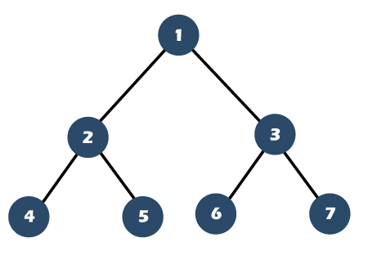
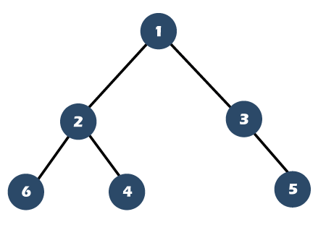
Difference
Complete Binary Tree
Incomplete Binary Tree

Slide 8
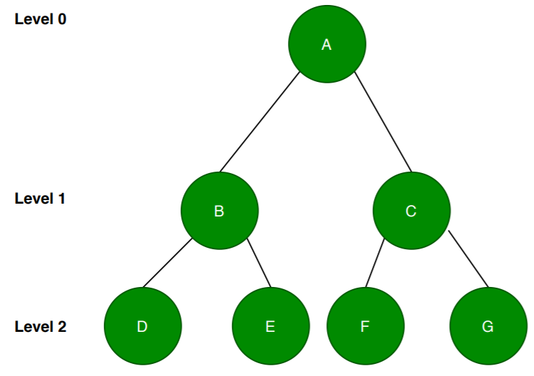
Visualisation:
A
B
C
D
E
F
G
Implement:
0
1
2
3
4
5
6
Formula:
Left(i) = 2i + 1
Right(i) = 2i + 2
Parent(i) = i-1
2

Slide 9
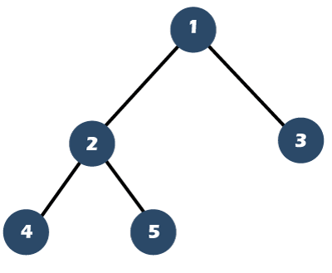
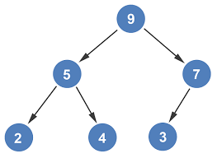
Heap
Min
Max

Slide 10
Application of Priority Queue
Dijkstra's Algorithm
Huffman Coding
Job Scheduling
Google map
Networking Algorithms
Operating system

Slide 11


